Slide 1

React - Redux

Slide 2
Redux
Redux is a State Management JavaScript Library.
A Predictable State Container for JavaScript Apps.
Predictable = able to be known
State Container = global state for entire app(store)
JavaScript Apps = React, Angular, Vue etc.,
It is most commonly used with libraries such as React or Angular for building user interfaces.
Redux was created by Dan Abramov and Andrew Clark in 2015.
Official Website: https://redux.js.org/
Definition:
Redux is a "state container" because it holds all the state of your application. It doesn't let you change that state directly, but instead forces you to describe changes as plain objects called "actions". Actions can be recorded and replayed later, so this makes state management predictable. With the same actions in the same order, you're going to end up in the same state.
By Dan Abramov

Slide 3
Similar libraries
Yes, we have few more libraries similar to Redux which are Flux and MobX.
Flux and MobX supports multiple stores whereas Redux supports single store.
Redux is more popular among three.

Slide 4
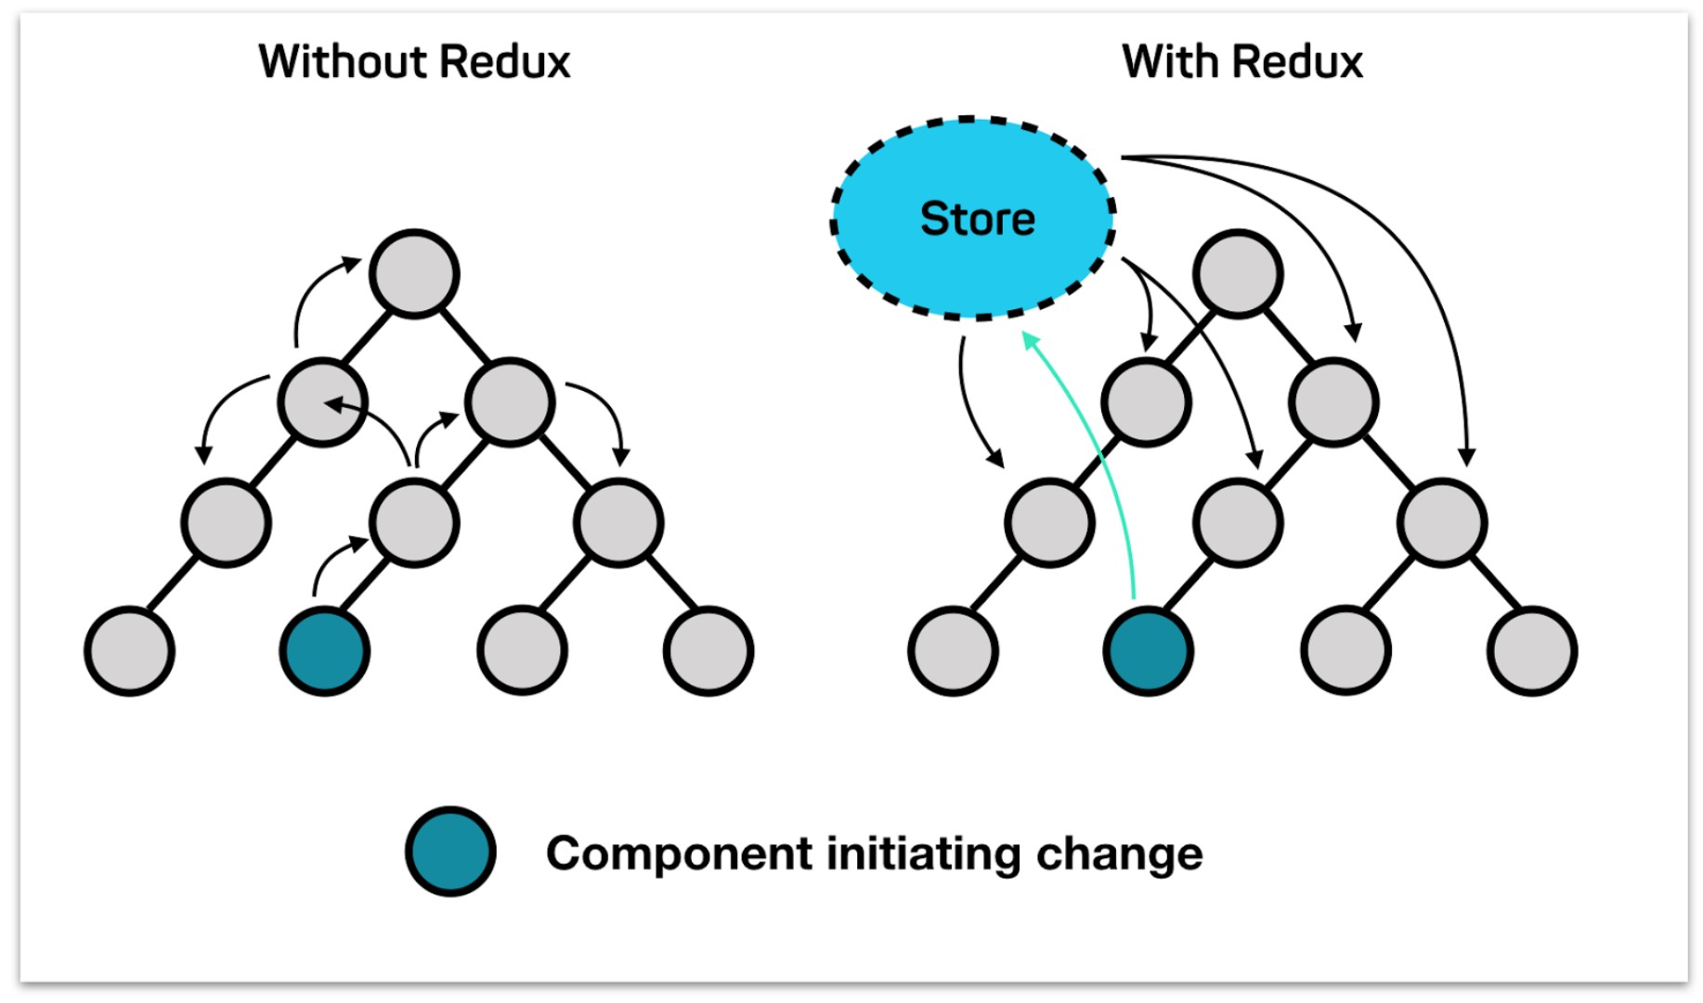
Why Redux ?
Component Header is searching for username state value which is present in Component UserDetails. Without Redux: We need to check all the components. Header UserDetails With Redux: We can directly access the global state without checking all the components.
Appcomp
NewDrug
DrugItemList
NewDrugForm
DrugItem
Header
UserDetails

Slide 5





Understand Scenario
Actions John wanted to Jessy wanted to Redux Store - Shop Reducer –Seller
“BUY_LAPTOP”
“BUY_MOBILE”

Slide 6
Redux Core Concepts/ Principles
1.Store
2.Action 3.Reducer
Example:
Let’s take a shop where customers can buy and sell mobiles and laptop
Shop = S t o r e
A Customer wanted to BUY_LAPTOP = Action
Laptop Seller = R educer

Slide 7
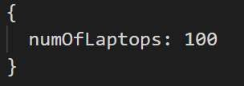
1.Sate
1.”The state of your whole application is stored in an object tree within a single store”
Shop:
Let’s assume that we are tracking the number of laptops in the shop.

Slide 8
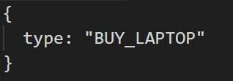
2. Actions
2.”The only way to change the state is to emit an action, an object describing what happened”
Not allowed to directly update the state object.
Shop:
Let the laptop seller know about our action – BUY_LAPTOP

Slide 9
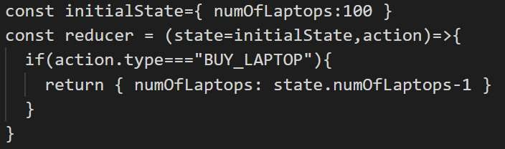
3. Reducers
3.”To specify how the state tree is transformed by actions, you write pure functions/reducers”
reducer – (previousState, action) => newState
Shop:
Laptop seller is the Reducer.

Slide 10

Redux Principles combined
Subscribed
JavaScript App
dispatch
Redux Store
(State)
Actions
Reducers

Slide 12
Let’s code
Create a simple node project:
npm init –y
Install Redux Package:
npm install redux

Slide 13
Middleware
To extend the redux with custom functionality. It provides a third-party extension point between dispatching an action, and the moment it reaches the reducer. Usually middleware used for logging, performing asynchronous operations etc., Let’s try redux-logger

Slide 14
Async
To extend the redux with custom functionality. It provides a third-party extension point between dispatching an action, and the moment it reaches the reducer. Usually middleware used for logging, performing asynchronous operations etc. If you want to do some async operations as actions which usually takes sometime to give output, then we can use redux-thunk as middleware.

Slide 15
React Redux
Install Packages: npm install redux react-redux redux-logger redux-thunk

